Slide 1
Neural Network Convergence
Specialization – AIML – Introduction to Deep Learning
By. Dr. Deepali Vora

Slide 2
What we know
Neural networks are universal approximators –
Can model any odd thing
Provided they have the right architecture
We must train them to approximate any function
Specify the architecture
Learn their weights and biases
Networks are trained to minimize total “error” on a training set
We do so through empirical risk minimization
We use variants of gradient descent to do so
The gradient of the error with respect to network parameters is computed through backpropagation

Slide 3
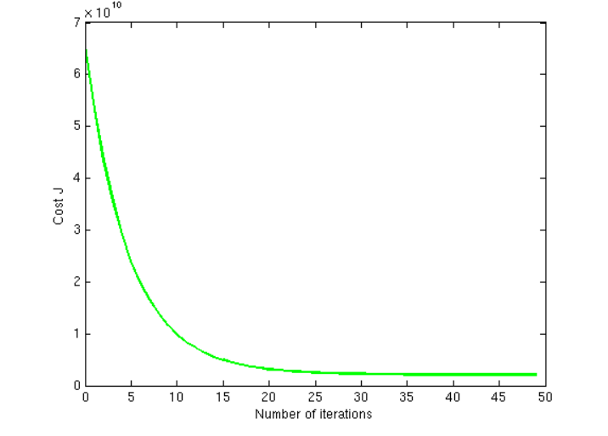
Convergence in NN
In the context of conventional artificial neural networks convergence describes a progression towards a network state where the network has learned to properly respond to a set of training patterns within some margin of error.
In other words, a model converges when additional training will not improve the model.
Notes:
A machine learning model reaches convergence when it achieves a state during training in which settles to within an error range around the final value.

Slide 4
BP and GD
Error is calculated
The convergence is based on how well we minimize the error
The training is faster if we minimize the error early by finding suitable weight values
But does training with GD using BP converge? And if converge then at what time?

Slide 5
The error surface for a linear neuron
The error surface lies in a space with a horizontal axis for each weight and one vertical axis for the error.
For a linear neuron with a squared error, it is a quadratic bowl.
Vertical cross-sections are parabolas.
Horizontal cross-sections are ellipses.
For multi-layer, non-linear nets the error surface is much more complicated.
But locally, a piece of a quadratic bowl is usually a very good approximation.
E
w1
w2

Slide 6
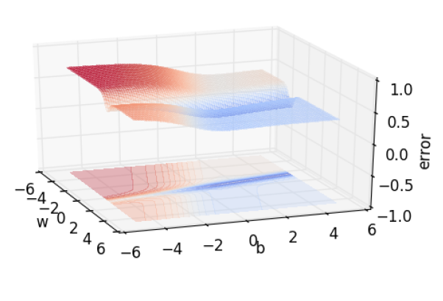
Error and error surface
Everything revolves around error

Slide 7
Local and Global Minima
strong
local
minimum
weak
local
minimum
strong
local
minimum
f(x)
Saddle Points
strong
global
minimum
feasible region
x

Slide 8
Local and Global Minima
strong
local
minimum
strong
local
minimum
f(x)
Saddle Points
strong
global
minimum
Saddle Point
feasible region
x

Slide 9


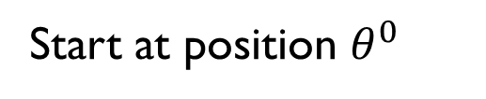
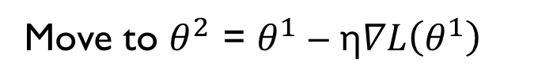



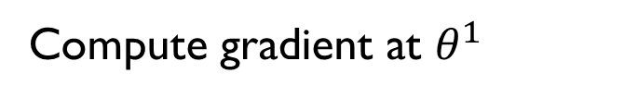




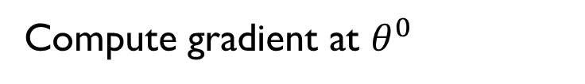


Gradient Descent
Gradient: Derivative of the Loss function
Gradient descent: direction of negative gradient
$$θ_{2}$$
$$∇L\left(θ^{0}\right)$$
Start at position $θ^{0}$
$$θ^{0}$$
$$∇L\left(θ^{1}\right)$$
Compute gradient at $θ^{0}$
$$θ^{1}$$
$$∇L\left(θ^{2}\right)$$
Move to $θ^{1}$ = $θ^{0}$ - η$∇L\left(θ^{0}\right)$
$$θ^{2}$$
Gradient
Compute gradient at $θ^{1}$
Movement
$$∇L\left(θ^{3}\right)$$
$$θ^{3}$$
Move to $θ^{2}$ = $θ^{1}$ – η$∇L\left(θ^{1}\right)$
……
$$θ_{1}$$
Notes:
Draw is so comply use Minecraft
Easy for more than two variables
Gradient: First order derivative for a multivariate objective function.

Slide 10
Gradient descent
Gradient descent can miss obvious answers – And this may be a good thing
Convergence issues abound – The error surface has many saddle points
Although, perhaps, not so many bad local minima
Gradient descent can stagnate on saddle points – Vanilla gradient descent may not converge, or may converge toooooo slowly
The optimal learning rate for one component may be too high or too low for others

Slide 11
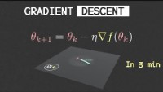
Gradient descent

Slide 12
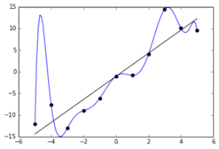
Gradient descent
So we run gradient descent until convergence, then what is the problem?
May converge on a local minima and require random restarts
Overfitting: a big problem for many years
How can we prevent overfitting?
How can we explore the search space better without getting stuck in local minima?
Notes:
Overfitting is a modeling error in statistics that occurs when a function is too closely aligned to a limited set of data points. ... Thus, attempting to make the model conform too closely to slightly inaccurate data can infect the model with substantial errors and reduce its predictive power.

Slide 13
Convergence speed of full batch learning when the error surface is a quadratic bowl
Going downhill reduces the error, but the direction of steepest descent does not point at the minimum unless the ellipse is a circle.
The gradient is big in the direction in which we only want to travel a small distance.
The gradient is small in the direction in which we want to travel a large distance.
Even for non-linear multi-layer nets, the error surface is locally quadratic, so the same speed issues apply.

Slide 14
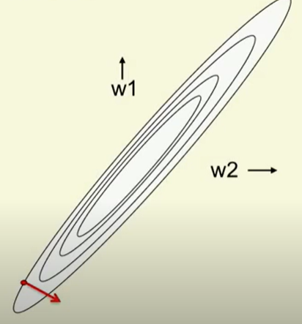
Convergence speed of full batch learning when the error surface is a quadratic bowl
Going downhill reduces the error, but the direction of steepest descent does not point at the minimum unless the ellipse is a circle.
The gradient is big in the direction in which we only want to travel a small distance.
The gradient is small in the direction in which we want to travel a large distance.
Even for non-linear multi-layer nets, the error surface is locally quadratic, so the same speed issues apply.

Slide 15
How the learning goes wrong
If the learning rate is big, the weights slosh to and fro across the ravine.
If the learning rate is too big, this oscillation diverges.
What we would like to achieve:
Move quickly in directions with small but consistent gradients.
Move slowly in directions with big but inconsistent gradients.
E
w

Slide 16
Stochastic gradient descent
A simple but beautifully powerful idea introduced by Leon Bottou in 2000
Original SGD:
While not converged:
Select a single datapoint in order from the data
Compute gradient with just one point
Update parameters
Pros: broader search
Cons: final solution may be poor, may be hard to converge

Slide 17
Stochastic gradient descent
If the dataset is highly redundant, the gradient on the first half is almost identical to the gradient on the second half.
So instead of computing the full gradient, update the weights using the gradient on the first half and then get a gradient for the new weights on the second half.
The extreme version of this approach updates weights after each case. Its called “online”.
Mini-batches are usually better than online.
Less computation is used updating the weights.
Computing the gradient for many cases simultaneously uses matrix-matrix multiplies which are very efficient, especially on GPUs
Mini-batches need to be balanced for classes

Slide 18
Two types of learning algorithm
If we use the full gradient computed from all the training cases, there are many clever ways to speed up learning
The optimization community has studied the general problem of optimizing smooth non-linear functions for many years.
Multilayer neural nets are not typical of the problems they study so their methods may need a lot of adaptation.
For large neural networks with very large and highly redundant training sets, it is nearly always best to use mini-batch learning.
The mini-batches may need to be quite big when adapting fancy methods.
Big mini-batches are more computationally efficient.

Slide 19
A basic mini-batch gradient descent algorithm
Guess an initial learning rate.
If the error keeps getting worse or oscillates wildly, reduce the learning rate.
If the error is falling fairly consistently but slowly, increase the learning rate.
Write a simple program to automate this way of adjusting the learning rate.
Towards the end of mini-batch learning it nearly always helps to turn down the learning rate.
This removes fluctuations in the final weights caused by the variations between mini-batches.
Turn down the learning rate when the error stops decreasing.
Use the error on a separate validation set

Slide 20
Be careful about turning down the learning rate
Turning down the learning rate reduces the random fluctuations in the error due to the different gradients on different mini-batches.
So we get a quick win.
But then we get slower learning.
Don’t turn down the learning rate too soon!
reduce learning rate
error
epoch

Slide 21
Learning Rate
Divergence-causing learning rates may not be a bad thing – Particularly for ugly loss functions
Decaying learning rates provide good compromise between escaping poor local minima and convergence
Many of the convergence issues arise because we force the same learning rate on all parameters

Slide 22
Initializing the weights
If two hidden units have exactly the same bias and exactly the same incoming and outgoing weights, they will always get exactly the same gradient.
So they can never learn to be different features.
We break symmetry by initializing the weights to have small random values.
If a hidden unit has a big fan-in, small changes on many of its incoming weights can cause the learning to overshoot.
We generally want smaller incoming weights when the fan-in is big, so initialize the weights to be proportional to sqrt(fan-in).
We can also scale the learning rate the same way.

Slide 23
Shifting the inputs
color indicates training case
When using steepest descent, shifting the input values makes a big difference.
It usually helps to transform each component of the input vector so that it has zero mean over the whole training set.
The hypberbolic tangent (which is 2*logistic -1) produces hidden activations that are roughly zero mean.
In this respect its better than the logistic.
101, 101 → 2
101, 99 → 0
gives error surface
1, 1 → 2
1, -1 → 0
gives error surface

Slide 24
Scaling the inputs
color indicates weight axis
When using steepest descent, scaling the input values makes a big difference.
It usually helps to transform each component of the input vector so that it has unit variance over the whole training set.
0.1, 10 → 2
0.1, -10 → 0
gives error surface
1, 1 → 2
1, -1 → 0
gives error surface

Slide 25
A more thorough method: Decorrelate the input components
For a linear neuron, we get a big win by decorrelating each component of the input from the other input components.
There are several different ways to decorrelate inputs. A reasonable method is to use Principal Components Analysis.
Drop the principal components with the smallest eigenvalues.
This achieves some dimensionality reduction.
Divide the remaining principal components by the square roots of their eigenvalues. For a linear neuron, this converts an axis aligned elliptical error surface into a circular one.
For a circular error surface, the gradient points straight towards the minimum.

Slide 26
Common problems that occur in multilayer networks
If we start with a very big learning rate, the weights of each hidden unit will all become very big and positive or very big and negative.
The error derivatives for the hidden units will all become tiny and the error will not decrease.
This is usually a plateau, but people often mistake it for a local minimum.
In classification networks that use a squared error or a cross-entropy error, the best guessing strategy is to make each output unit always produce an output equal to the proportion of time it should be a 1.
The network finds this strategy quickly and may take a long time to improve on it by making use of the input.
This is another plateau that looks like a local minimum.

Slide 27
What we discussed
Problem of local minimum
Learning rate – big or small
Decaying Learning rate
Weight initialisation – appropriate values
SGD – Mini Batch

Slide 28
Four ways to speed up mini-batch learning
rmsprop: Divide the learning rate for a weight by a running average of the magnitudes of recent gradients for that weight.
This is the mini-batch version of just using the sign of the gradient.
Take a fancy method from the optimization literature that makes use of curvature
Adapt it to work for neural nets
Adapt it to work for mini-batches.
Use “momentum”
Instead of using the gradient to change the position of the weight “particle”, use it to change the velocity.
Use separate adaptive learning rates for each parameter
Slowly adjust the rate using the consistency of the gradient for that parameter.

Slide 29
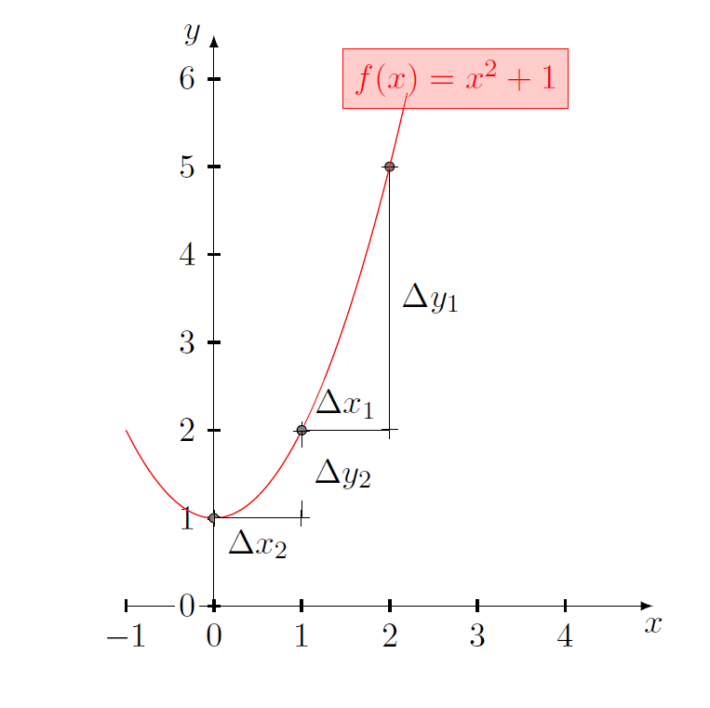
Some observations of gd
It takes a lot of time to navigate regions having a gentle slope
This is because the gradient in these regions is very small
Solution: Momentum

Slide 30
What we discussed
Problem of local minimum
Learning rate – big or small
Decaying Learning rate
Weight initialisation – appropriate values
SGD – Mini Batch
Started with variation in SGD - Momentum

Slide 31
The intuition behind the momentum method
Imagine a ball on the error surface. The location of the ball in the horizontal plane represents the weight vector.
The ball starts off by following the gradient, but once it has velocity, it no longer does steepest descent.
Its momentum makes it keep going in the previous direction.
It damps oscillations in directions of high curvature by combining gradients with opposite signs.
It builds up speed in directions with a gentle but consistent gradient.
Notes:
If I am repeatedly being asked to move in the same direction then I should
probably gain some confidence and start taking bigger steps in that direction
Just as a ball gains momentum while rolling down a slope

Slide 32
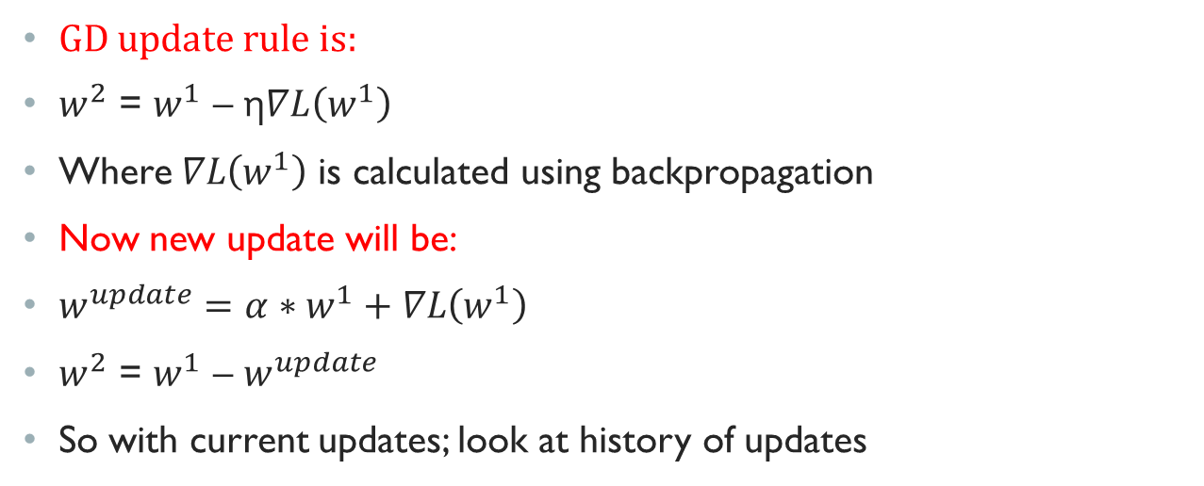
The update rule for gd with momentum
GD update rule is:
$w^{2}$ = $w^{1}$ – η$∇L\left(w^{1}\right)$
Where$∇L\left(w^{1}\right)$ is calculated using backpropagation
Now new update will be:
$w^{update}={α∗w}^{1}+∇L\left(w^{1}\right)$
$w^{2}$ = $w^{1}$ – $w^{update}$
So with current updates; look at history of updates
Notes:
The neural network's weights are changed in momentum-based gradient descent using the weighted sum of the previous gradient and the current gradient.
we take a fraction of the parameter update from the previous gradient step and add it to the current gradient step.

Slide 33
The equations of the momentum method
The effect of the gradient is to increment the previous velocity. The velocity also decays by α which is slightly less then 1.
The weight change is equal to the current velocity.
The weight change can be expressed in terms of the previous weight change and the current gradient.

Slide 34
The behavior of the momentum method
If the error surface is a tilted plane, the ball reaches a terminal velocity.
If the momentum is close to 1, this is much faster than simple gradient descent.
At the beginning of learning there may be very large gradients.
So it pays to use a small momentum (e.g. 0.5).
Once the large gradients have disappeared and the weights are stuck in a ravine the momentum can be smoothly raised to its final value (e.g. 0.9 or even 0.99)
This allows us to learn at a rate that would cause divergent oscillations without the momentum.

Slide 35
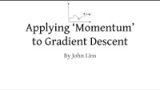
Momentum GD

Slide 36
CODE
SGD
Mini Batch
Momentum
SGD Code

Slide 37
The behavior of the momentum method
If the error surface is a tilted plane, the ball reaches a terminal velocity.
If the momentum is close to 1, this is much faster than simple gradient descent.
At the beginning of learning there may be very large gradients.
So it pays to use a small momentum (e.g. 0.5).
Once the large gradients have disappeared and the weights are stuck in a ravine the momentum can be smoothly raised to its final value (e.g. 0.9 or even 0.99)
This allows us to learn at a rate that would cause divergent oscillations without the momentum.

Slide 38
A better type of momentum (Nesterov 1983)
The standard momentum method first computes the gradient at the current location and then takes a big jump in the direction of the updated accumulated gradient.
Ilya Sutskever (2012 unpublished) suggested a new form of momentum that often works better.
Inspired by the Nesterov method for optimizing convex functions.
First make a big jump in the direction of the previous accumulated gradient.
Then measure the gradient where you end up and make a correction.
Its better to correct a mistake after you have made it!

Slide 39
A picture of the Nesterov method
First make a big jump in the direction of the previous accumulated gradient.
Then measure the gradient where you end up and make a correction.
brown vector = jump, red vector = correction, green vector = accumulated gradient
blue vectors = standard momentum

Slide 40
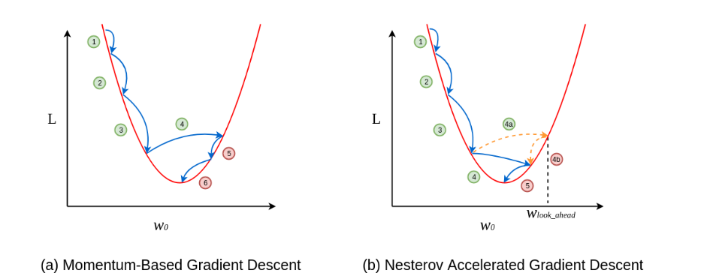
Nesterov gradient descent
https://www.codingninjas.com/studio/library/nesterov-accelerated-gradient

Slide 41
Nesterov gradient descent
First, the projected position of the entire solution is calculated using the change calculated in the last iteration of the algorithm.
projection(t+1) = x(t) + (momentum * change(t))
Then calculate the gradient for this new position.
gradient(t+1) = f'(projection(t+1))
Now we can calculate the new position of each variable using the gradient of the projection, first by calculating the change in each variable.
change(t+1) = (momentum * change(t)) – (step_size * gradient(t+1))
And finally, calculating the new value for each variable using the calculated change.
x(t+1) = x(t) + change(t+1)

Slide 42
Neural Networks for Machine Learning Lecture 6d A separate, adaptive learning rate for each connection
Geoffrey Hinton
with
Nitish Srivastava
Kevin Swersky

Slide 43
The intuition behind separate adaptive learning rates
In a multilayer net, the appropriate learning rates can vary widely between weights:
The magnitudes of the gradients are often very different for different layers, especially if the initial weights are small.
The fan-in of a unit determines the size of the “overshoot” effects caused by simultaneously changing many of the incoming weights of a unit to correct the same error.
So use a global learning rate (set by hand) multiplied by an appropriate local gain that is determined empirically for each weight.
Gradients can get very small in the early layers of very deep nets.
The fan-in often varies widely between layers.

Slide 44
One way to determine the individual learning rates
Start with a local gain of 1 for every weight.
Increase the local gain if the gradient for that weight does not change sign.
Use small additive increases and multiplicative decreases (for mini-batch)
This ensures that big gains decay rapidly when oscillations start.
If the gradient is totally random the gain will hover around 1 when we increase by plus half the time and decrease by times half the time.

Slide 45
Tricks for making adaptive learning rates work better
Adaptive learning rates can be combined with momentum.
Use the agreement in sign between the current gradient for a weight and the velocity for that weight (Jacobs, 1989).
Adaptive learning rates only deal with axis-aligned effects.
Momentum does not care about the alignment of the axes.
Limit the gains to lie in some reasonable range
e.g. [0.1, 10] or [.01, 100]
Use full batch learning or big mini-batches
This ensures that changes in the sign of the gradient are not mainly due to the sampling error of a mini-batch.

Slide 46
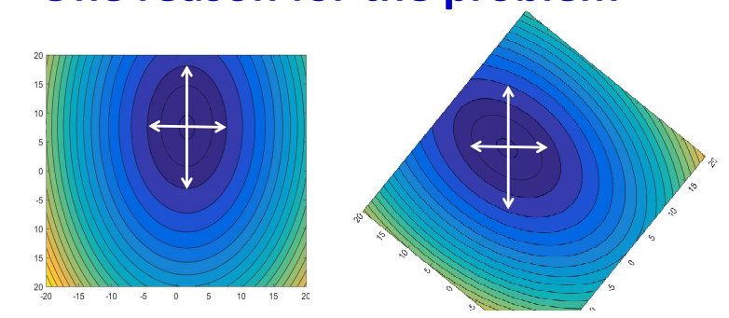
ERROR surface - axis

Slide 47
Learning Rate
Set the learning rate η carefully
If there are more than three parameters, you cannot visualize this.
Loss
Very Large
small
Large
Loss
Just make
No. of parameters updates
But you can always visualize this.
Notes:
Right: learning rate size (small, large…)

Slide 48
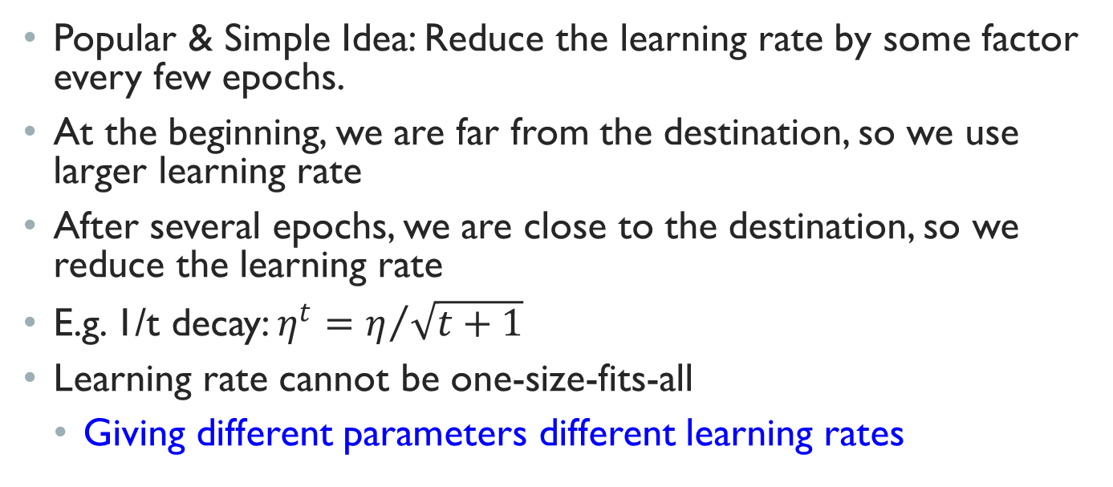
Adaptive Learning Rates
Popular & Simple Idea: Reduce the learning rate by some factor every few epochs.
At the beginning, we are far from the destination, so we use larger learning rate
After several epochs, we are close to the destination, so we reduce the learning rate
E.g. 1/t decay: $η^{t}=η/{\sqrt{t+1}}$
Learning rate cannot be one-size-fits-all
Giving different parameters different learning rates
Notes:
Advanced Idea: Eta
Can we give each parameters different learning rates?

Slide 49

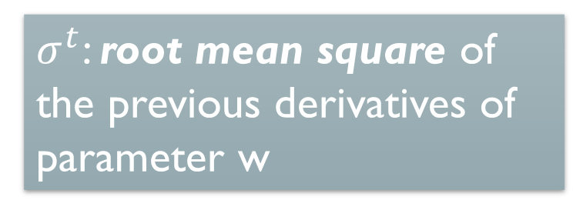
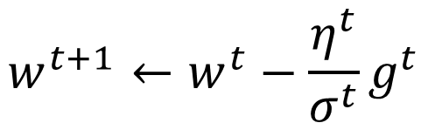
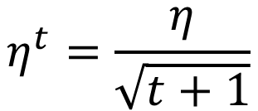

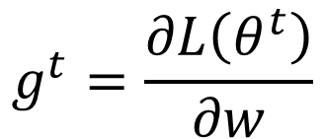
Adagrad
Vanilla Gradient descent
Divide the learning rate of each parameter by the root mean square of its previous derivatives
$$g^{t}=\frac{∂L\left(θ^{t}\right)}{∂w}$$
$$w^{t+1}←w^{t}−{\text{η}}^{t}g^{t}$$
w is one parameter
Adagrad
$σ^{t}$: root mean square of the previous derivatives of parameter w
$$η^{t}=\frac{η}{\sqrt{t+1}}$$
$$w^{t+1}←w^{t}−\frac{{\text{η}}^{t}}{σ^{t}}g^{t}$$
Parameter dependent
$$θ^{t+1}=θ^{t}−η∇L\left(θ^{t}\right)$$
Notes:
Each parameter has its own learning rate.
gt represents the gradient at the time t
nt represents the learning rate at time t (iteration t)
The learning rate is adjusted as per the sum of previous gradients – if gradients change is more then

Slide 50
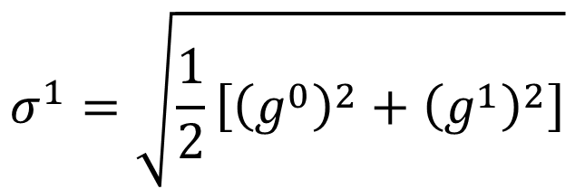
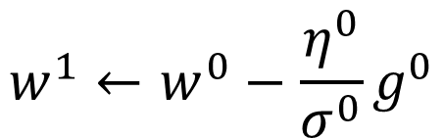

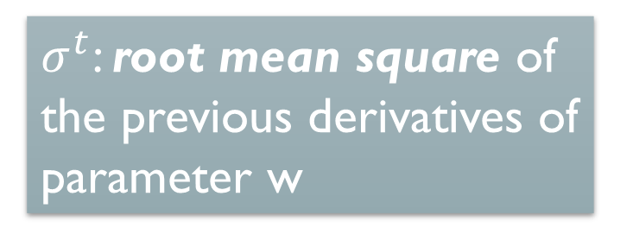
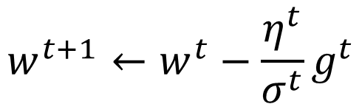
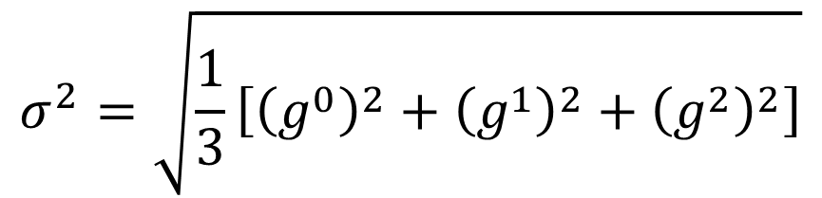
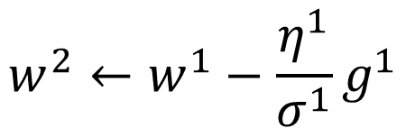
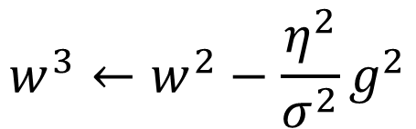

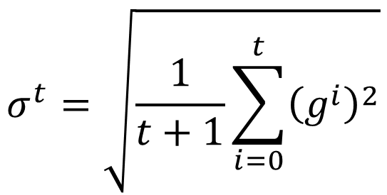
Adagrad
$$w^{1}←w^{0}−\frac{{\text{η}}^{0}}{σ^{0}}g^{0}$$
$$σ^{0}=\sqrt{{\left(g^{0}\right)}^{2}}$$
$$σ^{1}=\sqrt{\frac{1}{2}\left[{\left(g^{0}\right)}^{2}+{\left(g^{1}\right)}^{2}\right]}$$
$$w^{2}←w^{1}−\frac{{\text{η}}^{1}}{σ^{1}}g^{1}$$
$$σ^{2}=\sqrt{\frac{1}{3}\left[{\left(g^{0}\right)}^{2}+{\left(g^{1}\right)}^{2}+{\left(g^{2}\right)}^{2}\right]}$$
$$w^{3}←w^{2}−\frac{{\text{η}}^{2}}{σ^{2}}g^{2}$$
$$……$$
$$σ^{t}=\sqrt{\frac{1}{t+1}\sum_{i=0}^{t}{{\left(g^{i}\right)}^{2}}}$$
$σ^{t}$: root mean square of the previous derivatives of parameter w
$$w^{t+1}←w^{t}−\frac{{\text{η}}^{t}}{σ^{t}}g^{t}$$
Notes:
Why square

Slide 51



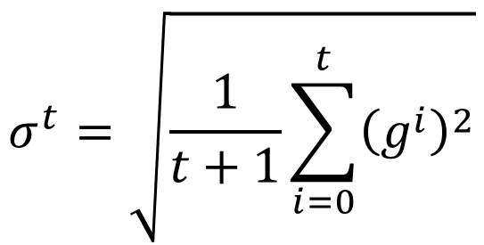
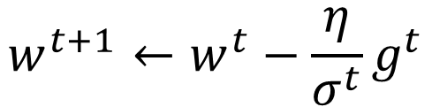
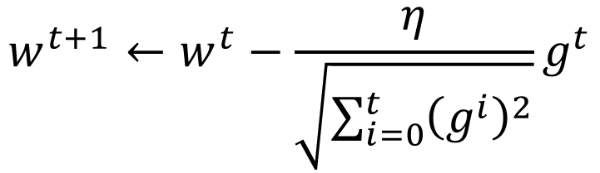
Adagrad
Divide the learning rate of each parameter by the root mean square of its previous derivatives
$$η^{t}=\frac{η}{\sqrt{t+1}}$$
1/t decay
$${\text{η}}^{t}$$
$$w^{t+1}←w^{t}−\frac{η}{σ^{t}}g^{t}$$
$$σ^{t}=\sqrt{\frac{1}{t+1}\sum_{i=0}^{t}{{\left(g^{i}\right)}^{2}}}$$
$$σ^{t}$$
$$w^{t+1}←w^{t}−\frac{η}{\sqrt{\sum_{i=0}^{t}{{\left(g^{i}\right)}^{2}}}}g^{t}$$

Slide 52
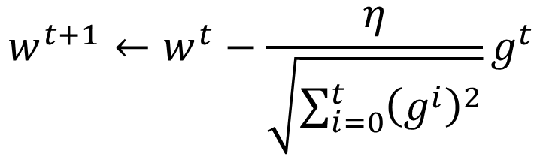
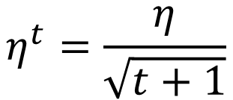
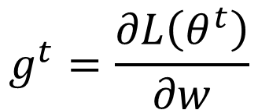

Contradiction?
Vanilla Gradient descent
Larger gradient,
larger step
$$η^{t}=\frac{η}{\sqrt{t+1}}$$
$$w^{t+1}←w^{t}−{\text{η}}^{t}g^{t}$$
Adagrad
Larger gradient,
larger step
$$w^{t+1}←w^{t}−\frac{η}{\sqrt{\sum_{i=0}^{t}{{\left(g^{i}\right)}^{2}}}}g^{t}$$
$$g^{t}=\frac{∂L\left(θ^{t}\right)}{∂w}$$
Larger gradient, smaller step
Notes:
Contradiction??????
Gradient and learning rate

Slide 53
ADAGRAD
Advantages
AdaGrad adjusts the learning rate for each parameter to enable effective updates based on the parameter’s significance to the optimization process. This method lessens the requirement for manual adjustment of learning rates.
Robustness: AdaGrad does well with sparse data and variables of different sizes. It makes sure that parameters that receive few updates get higher learning rates, which speeds up convergence.
Disadvantages
Accumulation of Squared Gradients: The AdaGrad sum of squared gradients has the potential to grow very big over time, which could cause the learning rate to drop too low. As a result, the algorithm may experience sluggish convergence or even premature stalling.
Lack of Control: AdaGrad does not provide fine-grained control over the learning rates of particular parameters because it globally accumulates squared gradients for all parameters. This may be an issue in circumstances where different learning speeds are necessary.
Notes:
sparse features, i.e., features that occur only infrequently.

Slide 54
Variations in adagrad
AdaGrad has a number of drawbacks, hence various modifications and enhancements have been suggested.
Some of them consist of:
RPROP: Considers the sign of gradient
RMSprop: To keep the learning rate from dropping too low, this form adds a decay term to the squared gradients.
AdaDelta: Rather than utilizing a global sum, it solves the issue of AdaGrad’s monotonically falling learning rate by employing a decaying average of previously squared gradients.
Adam: To more effectively manage the updating process, an extension of RMSprop incorporates momentum terms.
Notes:
RPROP: Considers the sign of gradient so that weights do not overshoot

Slide 55
Neural Networks for Machine Learning Lecture 6e rmsprop: Divide the gradient by a running average of its recent magnitude
Geoffrey Hinton
with
Nitish Srivastava
Kevin Swersky

Slide 56
rprop: Using only the sign of the gradient
The magnitude of the gradient can be very different for different weights and can change during learning.
This makes it hard to choose a single global learning rate.
For full batch learning, we can deal with this variation by only using the sign of the gradient.
The weight updates are all of the same magnitude.
This escapes from plateaus with tiny gradients quickly.
rprop: This combines the idea of only using the sign of the gradient with the idea of adapting the step size separately for each weight.
Increase the step size for a weight multiplicatively (e.g. times 1.2) if the signs of its last two gradients agree.
Otherwise decrease the step size multiplicatively (e.g. times 0.5).
Limit the step sizes to be less than 50 and more than a millionth (Mike Shuster’s advice).

Slide 57
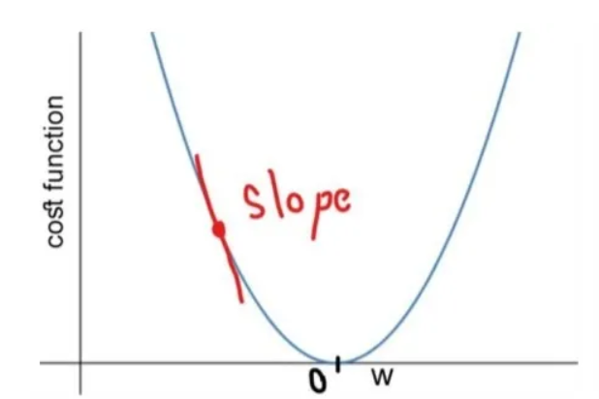
RPROP
Simple observation : If you overshoot the global minimum, the sign of the derivative will change. Otherwise, it won’t.
For each weight, if there was a sign change of the partial derivative of the total error function compared to the last iteration, the update value for that weight is multiplied by a factor η⁻, where η⁻ < 1.
If the last iteration produced the same sign, the update value is multiplied by a factor of η⁺, where η⁺ > 1.
The update values are calculated for each weight in the above manner, and finally each weight is changed by its own update value, in the opposite direction of that weight's partial derivative, so as to minimise the total error function. η⁺ is empirically set to 1.2 and η⁻ to 0.5.

Slide 58
Why rprop does not work with mini-batches
The idea behind stochastic gradient descent is that when the learning rate is small, it averages the gradients over successive mini-batches.
Consider a weight that gets a gradient of +0.1 on nine mini-batches and a gradient of -0.9 on the tenth mini-batch.
We want this weight to stay roughly where it is.
rprop would increment the weight nine times and decrement it once by about the same amount (assuming any adaptation of the step sizes is small on this time-scale).
So the weight would grow a lot.
Is there a way to combine:
The robustness of rprop.
The efficiency of mini-batches.
The effective averaging of gradients over mini-batches.

Slide 59
rmsprop: A mini-batch version of rprop
rprop is equivalent to using the gradient but also dividing by the size of the gradient.
The problem with mini-batch rprop is that we divide by a different number for each mini-batch. So why not force the number we divide by to be very similar for adjacent mini-batches?
rmsprop: Keep a moving average of the squared gradient for each weight
Dividing the gradient by makes the learning work much better.
Notes:
https://www.youtube.com/watch?v=ajI_HTyaCu8

Slide 60
Further developments of rmsprop
Combining rmsprop with standard momentum
Momentum does not help as much as it normally does. Needs more investigation.
Combining rmsprop with Nesterov momentum (Sutskever 2012)
It works best if the RMS of the recent gradients is used to divide the correction rather than the jump in the direction of accumulated corrections.
Combining rmsprop with adaptive learning rates for each connection
Needs more investigation.
Other methods related to rmsprop
Yann LeCun’s group has a fancy version in “No more pesky learning rates”

Slide 61
Adadelta
Adadelta updates the step size using a moving average of squared gradients
Adadelta uses two state variables:
Squared Gradient Accumulator (S): This accumulator keeps track of the exponentially weighted average of the squared gradients.
Squared Parameter Update Accumulator (Δx): This accumulator tracks the exponentially weighted average of the squared updates made to your model parameters.
Adadelta has no learning rate parameter. Instead, it uses the rate of change in the parameters itself to adapt the learning rate.
Adadelta requires two state variables to store the second moments of gradient and the change in parameters.
Notes:
https://statusneo.com/boosting-neural-network-adadelta-optimization-explained/
st to store a leaky average of the second moment of the gradient and Δxt to store a leaky average of the second moment of the change of parameters in the model itself

Slide 62
Adadelta - Parameter Update
AdaDelta uses a formula to update each model parameter based on the values stored in the accumulators.
The formula calculates the change (Δθ_t) to each parameter θ at each time step:
Δθ_t = – (RMS[Δx]_t-1 / RMS[S]_t-1) * ∇θ(loss)_t
θ_t = θ_t-1 + Δθ_t
Δθ_t represents the update to the parameter θ at time step t.
RMS[Δx]_t-1 is the root mean square of parameter updates up to time step t-1.
RMS[S]_t-1 is the root mean square of the squared gradients up to time step t-1.
∇θ(loss)_t is the gradient of the loss function concerning the parameter θ at time step t.

Slide 63
Adam (Adaptive Moment Estimation)
Adam combines the main ideas from two optimization techniques: momentum and RMSprop.
It is named adaptive as it adjusts the learning rate for each parameter.
Maintains an exponentially decaying average of past gradients and past squared gradients
1. The first moment vector (m):
It is an estimate of the mean (first moment) of gradients.
Calculated as an exponentially decaying average of past gradients.
Helps in estimating the direction of the gradient.
2. The second moment vector (v):
It’s an estimate of the uncentered variance (second moment) of the gradients.
Also calculated as an exponentially decaying average, but of squared gradients.
Helps in adapting the learning rate for each parameter.
Notes:
https://www.datacamp.com/tutorial/adam-optimizer-tutorial
Adam is like merging your skateboard (momentum) with your adaptive shoes (RMSprop) and adding a smart navigation system to the mix.
The skateboard part (momentum) keeps you going in the right general direction. This means that in downhill, smooth, and consistent regions, Adam allows you to move rapidly. In tricky, variable terrain, it helps you maintain a steady but cautious pace.
The adaptive shoes (RMSprop) sense where you’re going and adjust the skateboard’s grip. The smart navigation system (bias correction) in Adam is especially important at the start of your journey, where you start off from a random point and don’t know much about the terrain.
This combination of attributes is why Adam often finds the lowest point (the solution to the problem) in a very efficient manner and why its structure can handle different types of terrain (different types of machine learning problems) well.

Slide 64
Adam – key features
Adaptivity: Adam adapts the learning rate for each parameter, which can speed up learning in many cases.
Momentum: It uses a form of momentum, helping it navigate complex surfaces such as ravines and saddle points more effectively.
Bias correction: Adam includes bias correction terms, which help it perform well even in the initial stages of training.
Computational efficiency: It’s relatively computationally efficient and has low memory requirements.
Hyperparameter robustness: While the learning rate may need tuning, Adam is often less sensitive to hyperparameter choices than some other optimizers.

Slide 65
Flat regions in energy landscape
Notes:
Also lets us see how different kinds of learning algorithms work.

Slide 66
references
Deep Learning specialization – Coursera
Deep Learning Part 1 – NPTEL
https://d2l.ai/chapter_optimization/rmsprop.html

Slide 67
Summary of learning methods for neural networks
For small datasets (e.g. 10,000 cases) or bigger datasets without much redundancy, use a full-batch method.
Conjugate gradient, LBFGS ...
adaptive learning rates, rprop ...
For big, redundant datasets use mini-batches.
Try gradient descent with momentum.
Try rmsprop (with momentum ?)
Try LeCun’s latest recipe.
Why there is no simple recipe:
Neural nets differ a lot:
Very deep nets (especially ones with narrow bottlenecks).
Recurrent nets.
Wide shallow nets.
Tasks differ a lot:
Some require very accurate weights, some don’t.
Some have many very rare cases (e.g. words).

Slide 68
THANK YOU

